Slide 1
CSS is a language that describes the style of an HTML document.
CSS stands for Cascading Style Sheets
CSS describes how HTML elements are to be displayed on screen, paper, or in other media
CSS saves a lot of work. It can control the layout of multiple web pages all at once
External stylesheets are stored in CSS files
Why use css?
CSS is used to define styles for your web pages, including the design, layout and variations in display for different devices and screen sizes.
For example, CSS covers fonts, colours, margins, lines, height, width, background images, advanced positions and many other things.

Slide 2
Advantages of CSS
CSS saves time − You can write CSS once and then reuse same sheet in multiple HTML pages. You can define a style for each HTML element and apply it to as many Web pages as you want.
Pages load faster − If you are using CSS, you do not need to write HTML tag attributes every time. Just write one CSS rule of a tag and apply it to all the occurrences of that tag. So less code means faster download times.
Easy maintenance − To make a global change, simply change the style, and all elements in all the web pages will be updated automatically.
Superior styles to HTML − CSS has a much wider array of attributes than HTML, so you can give a far better look to your HTML page in comparison to HTML attributes.
Multiple Device Compatibility − Style sheets allow content to be optimized for more than one type of device. By using the same HTML document, different versions of a website can be presented for handheld devices such as PDAs and cell phones or for printing.

Slide 3
Global web standards − Now HTML attributes are being deprecated and it is being recommended to use CSS. So its a good idea to start using CSS in all the HTML pages to make them compatible to future browsers.
Offline Browsing − CSS can store web applications locally with the help of an offline cache. Using of this, we can view offline websites. The cache also ensures faster loading and better overall performance of the website.
Platform Independence − The Script offer consistent platform independence and can support latest browsers as well.

Slide 4
CSS SYNTAX

Slide 5
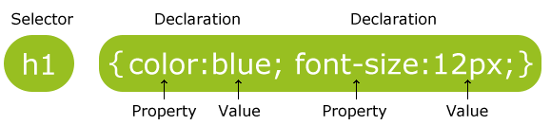
CSS syntax
A CSS rule-set consists of a selector and a declaration block:
Css syntax is made up of 3 parts: selector, property, value
The selector points to the HTML element you want to style.
The declaration block contains one or more declarations separated by semicolons.
Each declaration includes a CSS property name and a value, separated by a colon.
A CSS declaration always ends with a semicolon, and declaration blocks are surrounded by curly braces.

Slide 6
SELECTORS

Slide 7
CSS selectors
CSS selectors are used to "find" (or select) HTML elements based on their element name, id, class, attribute, and more.
Element Selector
Id selector
Class selector

Slide 8
a) Element selector
The element selector selects elements based on the element name.
You can select all <p> elements on a page like this (in this case, all <p> elements will be center-aligned, with a red text color):
<!DOCTYPE html>
<html>
<head>
<style>
p { text-align: center;
color: red;
}
</style>
</head>
<body>
<p>Every paragraph will be affected by the style.</p>
<p id="para1">Me too!</p>
<p>And me!</p>
</body>
</html>

Slide 9
b) Id selector
The id selector uses the id attribute of an HTML element to select a specific element.
The id of an element should be unique within a page, so the id selector is used to select one unique element!
To select an element with a specific id, write a hash (#) character, followed by the id of the element.
The style rule below will be applied to the HTML element with id="para1":
<html>
<head>
<style>
#para1 {
text-align: center;
color: red;
}
</style>
</head>
<body>
<p id="para1">Hello World!</p>
<p>This paragraph is not affected by the style.</p>
</body>
</html>

Slide 10
c) Class selector
The class selector selects elements with a specific class attribute.
To select elements with a specific class, write a period (.) character, followed by the name of the class.
In the example below, all HTML elements with class="center" will be red and center-aligned:
<!DOCTYPE html>
<html>
<head>
<style>
.center { text-align: center; color: red; }
</style>
</head>
<body>
<h1 class="center">Red and center-aligned heading</h1>
<p class="center">Red and center-aligned paragraph.</p>
</body>
</html>

Slide 11
You can also specify that only specific HTML elements should be affected by a class.
In the example below, only <p> elements with class="center" will be center-aligned:
<!DOCTYPE html>
<html>
<head>
<style>
p.center { text-align: center; color: red; }
</style>
</head>
<body>
<h1 class="center">This heading will not be affected</h1>
<p class="center">This paragraph will be red and center-aligned.</p>
</body>
</html>

Slide 12
Grouping selectors
If you have elements with the same style definitions, like this:
h1 { text-align: center; color: red; } h2 { text-align: center; color: red; } p { text-align: center; color: red; }
It will be better to group the selectors, to minimize the code.
To group selectors, separate each selector with a comma.
h1, h2, p { text-align: center; color: red; }

Slide 13
Universal selector
The * selector selects all elements.
<!DOCTYPE html>
<html> <head>
<style>
* { color: yellow;}
</style>
</head><body>
<h1>Welcome to My Homepage</h1>
<div class="intro"> <p id="firstname">My name is Donald.</p>
<p id="hometown">I live in Duckburg.</p>
</div>
<p>My best friend is Mickey.</p></body>

Slide 14
Ways to insert CSS

Slide 15
There are three ways of inserting a style sheet:
External style sheet
Internal style sheet
Inline style

Slide 16
a) External style sheet
An external style sheet is ideal when the style is applied to many pages.
With an external style sheet, you can change the look of an entire website by changing just one file!
Each page must include a reference to the external style sheet file inside the <link> element.
The <link> element goes inside the <head> section.
<head> <link rel="stylesheet“ type="text/css" href="mystyle.css"> </head>
An external style sheet can be written in any text editor.
The file should not contain any html tags.
The style sheet file must be saved with a .css extension.
Example “mystyle.css” content
body { background-color: lightblue; } h1 { color: navy; margin-left: 20px; }

Slide 17
b) Internal style sheet
An internal style sheet may be used if one single page has a unique style.
Internal styles are defined within the <style> element, inside the <head> section of an HTML page:
<!DOCTYPE html>
<html>
<head>
<style>
body {
background-color: linen;
}
h1 {
color: maroon;
margin-left: 40px;
}
</style>
</head>
<body>
<h1>This is a heading</h1>
<p>This is a paragraph.</p>
</body>
</html>

Slide 18
c) Inline style
An inline style may be used to apply a unique style for a single element.
To use inline styles, add the style attribute to the relevant element. The style attribute can contain any CSS property.
The example below shows how to change the color and the left margin of a <h1> element:
<h1 style="color:blue;margin-left:30px;">This is a heading</h1>

Slide 19
Cascading order

Slide 20
What style will be used when there is more than one style specified for an html element?
Priority of style sheets are:
Inline style(inside an HTML element, hghest priority)
External and internal style sheets (in the head section)
Browser default
So, inline style has the highest priority , which means that it will override a style defined inside the <head> tag, or in an external style sheet, or a browser default value.

Slide 21
Text formatting
This text is styled with some of the text formatting properties. The heading uses the text-align, text-transform, and color properties. The paragraph is indented, aligned, and the space between characters is specified.

Slide 22
Text formatting property:
Color
alignment
decoration
Transformation
Indentation
Letter spacing
Line height
Text direction
Word spacing
Text shadow

Slide 23
.
a) Text color
The color property is used to set the color of the text
With CSS, a color is most often specified by:
a color name - like "red"
a HEX value - like "#ff0000"
an RGB value - like "rgb(255,0,0)“
Example:
body { color: blue; } h1 { color: green; }

Slide 24
b) Text alignment
The text-align property is used to set the horizontal alignment of a text.
A text can be left or right aligned, centered, or justified.
When the text-align property is set to "justify", each line is stretched so that every line has equal width, and the left and right margins are straight
Example:
h1 { text-align: center; } h2 { text-align: left; } h3 { text-align: right; }
div { text-align: justify; }

Slide 25
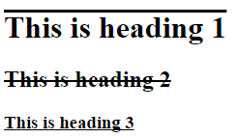
Text decoration
The text-decoration property is used to set or remove decorations from text.
Example:
h1 { text-decoration: overline; } h2 { text-decoration: line-through; } h3 { text-decoration: underline; }
//to remove underlines from the links
a { text-decoration: none; }

Slide 26
Text transformation
The text-transform property is used to specify uppercase and lowercase letters in a text.
It can be used to turn everything into uppercase or lowercase letters, or capitalize the first letter of each word:
Example:
p.uppercase { text-transform: uppercase; } p.lowercase { text-transform: lowercase; } p.capitalize { text-transform: capitalize; }

Slide 27
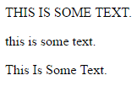
<head>
<style>
p.uppercase { text-transform: uppercase;
}
p.lowercase { text-transform: lowercase;
}
p.capitalize { text-transform: capitalize;
}
</style>
</head>
<body>
<p class="uppercase">This is some text.</p>
<p class="lowercase">This is some text.</p>
<p class="capitalize">This is some text.</p>
</body>

Slide 28
Indentation
Used to specify the indentation of the first line of a text
Example:
p { text-indent: 50px; }

Slide 29
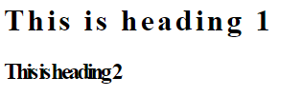
Letter spacing
The letter-spacing property is used to specify the space between the characters in a text.
The following example demonstrates how to increase or decrease the space between characters:
Example:
h1 { letter-spacing: 3px; } h2 { letter-spacing: -3px; }

Slide 30
Line height
The line-height property is used to specify the space between lines:
Example:
p.small { line-height: 0.8; } p.big { line-height: 1.8; }

Slide 31
Text direction
The direction property is used to change the text direction of an element:
Example:
div { direction: rtl; }
Word spacing
The word-spacing property is used to specify the space between the words in a text.
Example:
h1 { word-spacing: 10px; } h2 { word-spacing: -5px; }

Slide 32
Text shadow
The text-shadow property adds shadow to text.
The following example specifies the position of the horizontal shadow (3px), the position of the vertical shadow (2px) and the color of the shadow (red):
Example:
h1 { text-shadow: 3px 2px red; }

Slide 33
Background

Slide 34
The CSS background properties are used to define the background effects for elements.
CSS background properties:
background-color
background-image
background-repeat
background-attachment
background-position

Slide 35
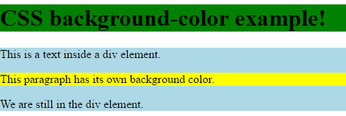
Background color
The background-color property specifies the background color of an element.
Example:
h1 { background-color: green; } div { background-color: lightblue; } p { background-color: yellow; }

Slide 36
Background image
The background-image property specifies an image to use as the background of an element.
By default, the image is repeated so it covers the entire element.
Example:
body { background-image: url("paper.gif"); }

Slide 37
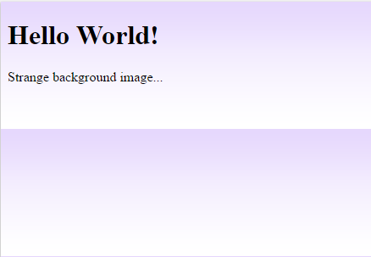
Background image-repeat horizontally or vertically
By default, the background-image property repeats an image both horizontally and vertically.
Some images should be repeated only horizontally or vertically, or they will look strange, like this:
Example:
body { background-image: url("gradient_bg.png"); }

Slide 38
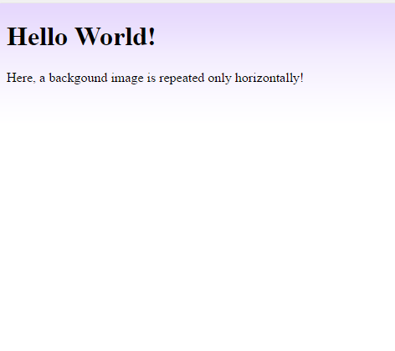
If the image above is repeated only horizontally (background-repeat: repeat-x;), the background will look better:
To repeat an image vertically, set background-repeat: repeat-y;
Example:
body { background-image: url("gradient_bg.png"); background-repeat: repeat-x; }

Slide 39
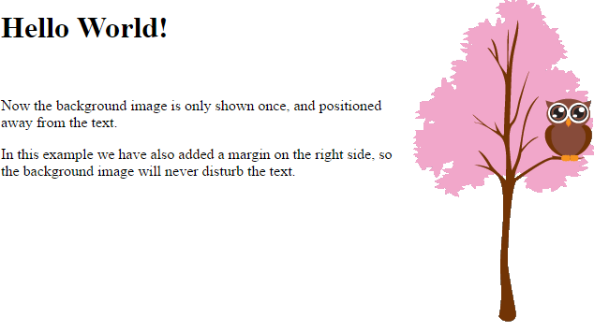
Set position and no-repeat
If background image is shown in the same place as the text. We want to change the position of the image, so that it does not disturb the text too much.
The position of the image is specified by the background-position property:
Example:
body { background-image: url("img_tree.png"); background-repeat: no-repeat; background-position: right top; }

Slide 40
Background image – fixed position
To specify that the background image should be fixed (will not scroll with the rest of the page), use the background-attachment property:
Example:
body { background-image: url("img_tree.png"); background-repeat: no-repeat; background-position: right top; background-attachment: fixed; }

Slide 41
Margin

Slide 42
The CSS margin properties are used to generate space around elements.
The margin properties set the size of the white space outside the border.
With CSS, you have full control over the margins. There are CSS properties for setting the margin for each side of an element (top, right, bottom, and left).
CSS has properties for specifying the margin for each side of an element:
a) margin-top
b) margin-right
c) margin-bottom
d) margin-left
All the margin properties can have the following values:
a) auto - the browser calculates the margin
b) length - specifies a margin in px, pt, cm, etc.
c) % - specifies a margin in % of the width of the containing element
d) inherit - specifies that the margin should be inherited from the parent element
Tip: Negative values are allowed.

Slide 43
Example:
p { margin-top: 100px; margin-bottom: 100px; margin-right: 150px; margin-left: 80px; }
Margin shorthand
Example:
p { margin: 100px 150px 100px 80px; }
If the margin property has three values:
margin: 25px 50px 75px;
top margin is 25px
right and left margins are 50px
bottom margin is 75px
If the margin property has two values:
margin: 25px 50px;
top and bottom margins are 25px
right and left margins are 50px
If the margin property has one value:
margin: 25px;
all four margins are 25px

Slide 44
Auto value
You can set the margin property to auto to horizontally center the element within its container.
The element will then take up the specified width, and the remaining space will be split equally between the left and right margins:
Example:
div { width: 300px; margin: auto; border: 1px solid red; }

Slide 45
Inherit value
<head>
<style>
div.container {
border: 1px solid red;
margin-left: 100px;
}
p.one {
margin-left: inherit;
}
</style>
</head>
<body>
<div class="container">
<p class="one">This is a paragraph with an inherited left margin (from the div element).</p>
</div>
</body>

Slide 46
Position

Slide 47
Position property
The position property specifies the type of positioning method used for an element (static, relative, fixed or absolute).
The position property specifies the type of positioning method used for an element.
There are four different position values:
a) static
b) relative
c) fixed
d) Absolute
Elements are then positioned using the top, bottom, left, and right properties. However, these properties will not work unless the position property is set first. They also work differently depending on the position value.

Slide 48
Position: static;
HTML elements are positioned static by default.
Static positioned elements are not affected by the top, bottom, left, and right properties.
An element with position: static; is not positioned in any special way; it is always positioned according to the normal flow of the page:
Example:
.static { position: static; border: 3px solid #73AD21; }

Slide 49
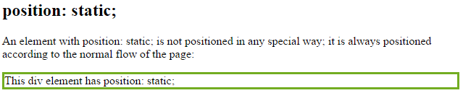
<style>
div.static {
position: static;
border: 3px solid #73AD21;
}
</style>
</head>
<body>
<h2>position: static;</h2>
<p>An element with position: static; is not positioned in any special way; it is
always positioned according to the normal flow of the page:</p>
<div class="static">
This div element has position: static;
</div>

Slide 50
position: relative;
An element with position: relative; is positioned relative to its normal position.
Setting the top, right, bottom, and left properties of a relatively-positioned element will cause it to be adjusted away from its normal position. Other content will not be adjusted to fit into any gap left by the element.
Example:
div.relative { position: relative; left: 30px; border: 3px solid #73AD21; }

Slide 51
position: fixed;
An element with position: fixed; is positioned relative to the viewport, which means it always stays in the same place even if the page is scrolled.
The top, right, bottom, and left properties are used to position the element.
A fixed element does not leave a gap in the page where it would normally have been located.
Notice the fixed element in the lower-right corner of the page. Here is the CSS that is used:
Example:
div.fixed { position: fixed; bottom: 0; right: 0; width: 300px; border: 3px solid #73AD21; }

Slide 52
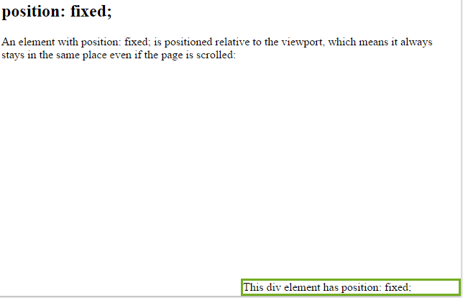
<head>
<style>
div.fixed {
position: fixed;
bottom: 0;
right: 0;
width: 300px;
border: 3px solid #73AD21;
}
</style>
</head>
<body>
<h2>position: fixed;</h2>
<p>An element with position: fixed; is positioned relative to the viewport, which means it always stays in the same place even if the page is scrolled:</p>
<div class="fixed">
This div element has position: fixed;
</div>

Slide 53
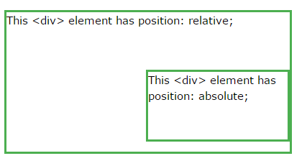
position: absolute;
An element with position: absolute; is positioned relative to the nearest positioned ancestor (instead of positioned relative to the viewport, like fixed).
However; if an absolute positioned element has no positioned ancestors, it uses the document body, and moves along with page scrolling.
Example:
div.relative { position: relative; width: 400px; height: 200px; border: 3px solid #73AD21;
}
div.absolute { position: absolute; top: 80px; right: 0; width: 200px; height: 100px; border: 3px solid #73AD21; }

Slide 54
Navigation bar

Slide 55
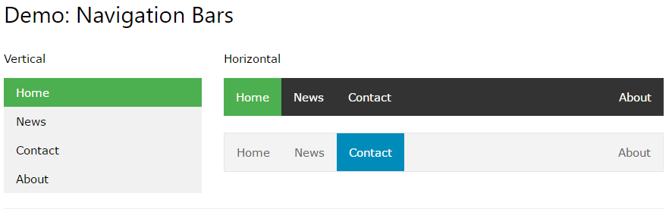

Slide 56
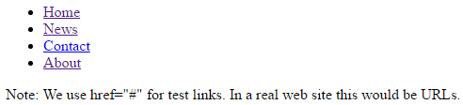
Navigation Bar = List of Links
A navigation bar needs standard HTML as a base.
We can build the navigation bar from a standard HTML list.
A navigation bar is basically a list of links, so using the <ul> and <li> elements makes perfect sense:
EXAMPLE:
<html>
<body>
<ul>
<li><a href="#home">Home</a></li>
<li><a href="#news">News</a></li>
<li><a href="#contact">Contact</a></li>
<li><a href="#about">About</a></li>
</ul>
<p>Note: We use href="#" for test links.
In a real web site this would be URLs.</p>
</body>
<html>
OUTPUT:

Slide 57
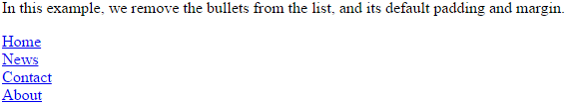
Incase you don’t want bullets and margin and paddings from the list add following <style> to the head section:
<head>
<style>
ul { list-style-type: none;
margin: 0;
padding: 0;
}
</style>
</head>
Example explained:
list-style-type: none; - Removes the bullets. A navigation bar does not need list markers
Set margin: 0; and padding: 0; to remove browser default settings
The code in the example above is the standard code used in both vertical, and horizontal navigation bars.
OUTPUT:

Slide 58
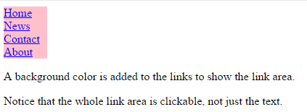
Vertical navigation bar
To build a vertical navigation bar, you can style the <a> elements inside the list in head section, in addition to the code above:
<head>
<style>
ul { list-style-type: none;
margin: 0;
padding: 0;
}
li a { display: block;
width:60px;
background-color: pink;
}
</style>
</head>
OUTPUT:

Slide 59

If you want to change the background color of the links when the user moves the mouse over them. Add the following code to style tag in previous code:
/* Change the link color on hover */
li a:hover {
background-color: #555;
color: white;
}
OUTPUT:

Slide 60
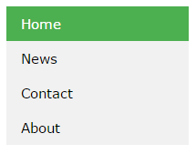
Active/Current Navigation Link
Add an "active" class to the current link to let the user know which page he/she is on:
Example : user is currently on home page
Add following code to style
.active { background-color: #4CAF50; color: white; }

Slide 61
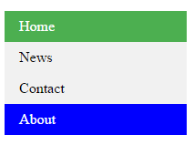
If you want to give color to other links than current page when you move the mouse over them:
li a:hover:not(.active)
{
background-color: blue;
color: white;
}

Slide 62
<!DOCTYPE html> <html> <head> <style>
ul { list-style-type: none;
margin: 0;
padding: 0;
width: 200px;
background-color: #f1f1f1;
}
li a { display: block;
color: #000;
padding: 8px 16px;
text-decoration: none;
}
li a.active { background-color: #4CAF50;
color: white;
}
li a:hover:not(.active) {
background-color: blue;
color: white;
}
</style> </head>
<body>
<h2>Vertical Navigation Bar</h2>
<p>In this example, we create an "active" class with a green background color and a white text. The class is added to the "Home" link.</p>
<ul>
<li><a class="active" href="#home">Home</a></li>
<li><a href="#news">News</a></li>
<li><a href="#contact">Contact</a></li>
<li><a href="#about">About</a></li>
</ul>
</body>
</html>

Slide 63
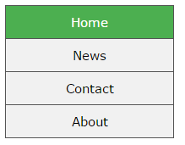
Center Links & Add Borders
Add text-align:center to <li> or <a> to center the links.
Add the border property to <ul> add a border around the navbar.
If you also want borders inside the navbar, add a border-bottom to all <li> elements, except for the last one:
ul { border: 1px ; } li { text-align: center; border-bottom: 1px; } li:last-child { border-bottom: none; }

Slide 64
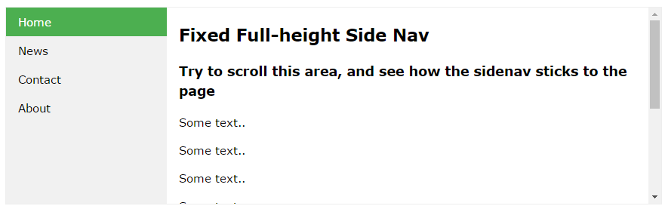
Full-height Fixed Vertical Navbar
Create a full-height, "sticky" side navigation:
ul { list-style-type: none; margin: 0; padding: 0; width: 25%; background-color: #f1f1f1; height: 100%; /* Full height */ position: fixed; /* Make it stick, even on scroll */ overflow: auto; /* Enable scrolling if the sidenav has too much content */ }

Slide 65
Horizontal navigation bar
There are two ways to create a horizontal navigation bar.
a) Using inline or
b) floating list items.

Slide 66
a) Inline List Items
One way to build a horizontal navigation bar is to specify the <li> elements as inline, in addition to the "standard" code above:
li { display: inline; }
Example explained:
display: inline; - By default, <li> elements are block elements. Here, we remove the line breaks before and after each list item, to display them on one line

Slide 67

INLINE EXAMPLE
<!DOCTYPE html>
<html>
<head>
<style>
ul {
list-style-type: none;
margin: 0;
padding: 0;
}
li {
display: inline;
}
</style>
</head>
<body>
<ul>
<li><a href="#home">Home</a></li>
<li><a href="#news">News</a></li>
<li><a href="#contact">Contact</a></li>
<li><a href="#about">About</a></li>
</ul>
</body>
</html>
output

Slide 68
Floating List Items
Another way of creating a horizontal navigation bar is to float the <li> elements, and specify a layout for the navigation links:
li { float: left; } a { display: block; padding: 8px; background-color: #dddddd; }
Example explained:
float: left; - use float to get block elements to slide next to each other
display: block; - Displaying the links as block elements makes the whole link area clickable (not just the text), and it allows us to specify padding (and height, width, margins, etc. if you want)
padding: 8px; - Since block elements take up the full width available, they cannot float next to each other. Therefore, specify some padding to make them look good
background-color: #dddddd; - Add a gray background-color to each a element

Slide 69

FLOAT EXAMPLE
<!DOCTYPE html>
<html> <head> <style>
ul { list-style-type: none;
margin: 0;
padding: 0;
overflow: hidden;
}
li { float: left;
}
li a { display: block;
padding: 8px;
background-color: #dddddd;
}
</style> </head>
<body>
<ul> <li><a href="#home">Home</a></li>
<li><a href="#news">News</a></li>
<li><a href="#contact">Contact</a></li>
<li><a href="#about">About</a></li>
</ul>
<p><b>Note:</b> If a !DOCTYPE is not specified, floating items can produce unexpected results.</p>
</body>
</html>
output

Slide 70
Right-Align Links
Right-align links by floating the list items to the right (float:right;):
<ul> <li><a href="#home">Home</a></li> <li><a href="#news">News</a></li> <li><a href="#contact">Contact</a></li> <li style="float:right"><a class="active" href="#about">About</a></li> </ul>

Slide 71
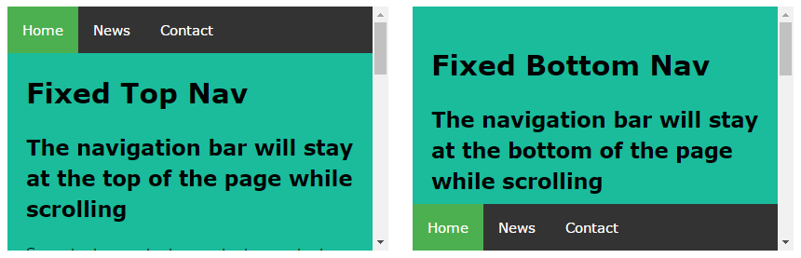
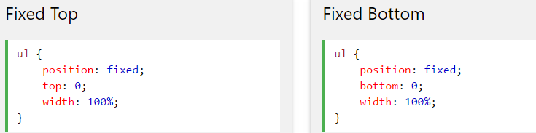
Fixed Navigation Bar
Make the navigation bar stay at the top or the bottom of the page, even when the user scrolls the page:

Slide 72
Align

Slide 73
Center align element
To horizontally center a block element (like <div>), use margin: auto;
Setting the width of the element will prevent it from stretching out to the edges of its container.
The element will then take up the specified width, and the remaining space will be split equally between the two margins:
Example:
.center { margin: auto; width: 50%; border: 3px solid green; padding: 10px; }
Note: Center aligning has no effect if the width property is not set (or set to 100%).

Slide 74
Center align text
To just center the text inside an element, use text-align: center;
Example:
.center { text-align: center; border: 3px solid green; }

Slide 75
Center align element
To center an image, use margin: auto; and make it into a block element:
Example:
<style>
img {
display:block;
margin: auto;
}
</style>
</head>
<body>
<h2>Center an Image</h2>
<p>To center an image, use margin: auto; and make it into a block element:</p>
<img src="paris.jpg" alt="Paris" style="width:40%">
</body>

Slide 76
Left and right align- using position
One method for aligning elements is to use position: absolute;:
Example:
.right { position: absolute; right: 0px; width: 300px; border: 3px solid #73AD21; padding: 10px; }
Tip: When aligning elements with position, always define margin and padding for the <body> element. This is to avoid visual differences in different browsers.

Slide 77
Left and right align using float
Another method for aligning elements is to use the float property:
Example:
.right { float: right; width: 300px; border: 3px solid #73AD21; padding: 10px;
background-color: #b0e0e6; }
Tip: When aligning elements with float, always define margin and padding for the <body> element. This is to avoid visual differences in different browsers.

Slide 78
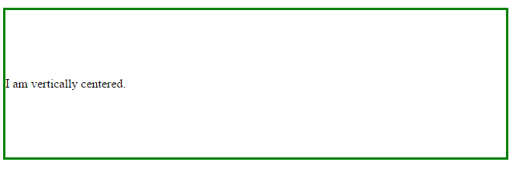
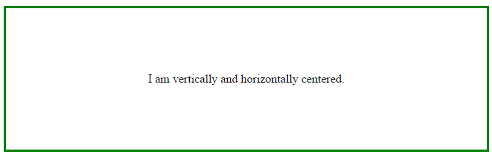
Center vertically & horzizontally-using padding
There are many ways to center an element vertically in CSS. A simple solution is to use top and bottom padding:
Example:
.center { padding: 70px 0; border: 3px solid green; }
To center both vertically and horizontally, use padding and text-align: center:
Example:
.center { padding: 70px 0; border: 3px solid green; text-align: center; }

Slide 79
Center Vertically - Using line-height
Another trick is to use the line-height property with a value that is equal to the height property.
Example:
.center { line-height: 200px; height: 200px; border: 3px solid green; text-align: center; }

Slide 80
Image gallery

Slide 81
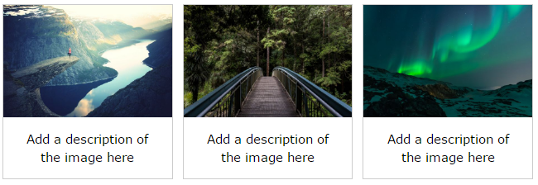
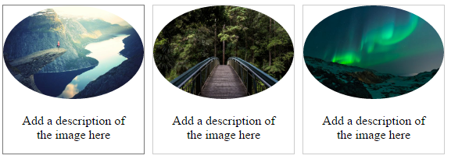
CSS can be used to create an image gallery.
Example 1:
Example 2:

Slide 82
<!DOCTYPE html> <html> <head>
<style>
div.gallery { margin: 5px;
border: 1px solid #ccc;
float: left;
width: 180px }
div.gallery:hover { border: 1px solid #777; }
div.gallery img { width: 100%;
height: auto;
border-radius: 50%; }
div.desc { padding: 15px;
text-align: center; }
</style> </head>
<body>
<div class="gallery">
<a target="_blank" href="img_fjords.jpg">
<img src="img_fjords.jpg" alt="Trolltunga Norway" width="300" height="200">
</a>
<div class="desc">Add a description of the image here</div>
</div>
<div class="gallery">
<a target="_blank" href="img_forest.jpg">
<img src="img_forest.jpg" alt="Forest" width="600" height="400"> </a>
<div class="desc">Add a description of the image here</div>
</div>
<div class="gallery">
<a target="_blank" href="img_lights.jpg">
<img src="img_lights.jpg" alt="Northern Lights" width="600" height="400"> </a>
<div class="desc">Add a description of the image here</div>
</div>
</body> </html>

Slide 83
For example 1 : Previous slide code
For example 2: Rounded image
div.Gallery img {
width: 100%;
height: auto;
border-radius: 50%;
}

Slide 84
The display property specifies if/how an element is displayed.
Every HTML element has a default display value depending on what type of element it is.
Block-level Elements
A block-level element always starts on a new line and takes up the full width available (stretches out to the left and right as far as it can).
The <div> element is a block-level element.
Examples of block-level elements:
<div>,<p>,<form>
Inline Elements
An inline element does not start on a new line and only takes up as much width as necessary.
This is an inline <span> element inside a paragraph.
Examples of inline elements:
<span>,<a>,<img>
Hiding an element can be done by setting the display property to none. The element will be hidden, and the page will be displayed as if the element is not there

